Slide 1
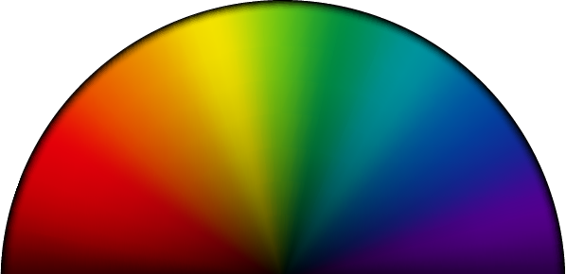
Universal Light Controller
By: Darrick, Neldinson, Asma

Slide 2
Our design question
"How might we control every LED strip in a room from one simple controller?"

Slide 3
01
Team Forming

Slide 4
We formed a three-person team and split the work by strengths
Darrick
Neldinson
Asma
Electrical Engineering
Electrical Engineering
Systems Engineering

Slide 5
02
Empathizing with users

Slide 6
We found four pain points in how people control LED strips today
Many remotes
Needs a phone
Every strip brand ships its own remote or app
App strips need a phone and often Wi-Fi and different apps
No syncing
No saving
Different brands cannot match colors
Basic remotes cannot save a custom color

Slide 7
Each user need became a design requirement for our prototype
User need | Requirement | In the prototype
One control for every LED-strip | Talk to many LED-strips at once | Up to 10 LED-strips, plus "All lights"
No phone or app | Physical controls | A screen and one dial
Keep favorite colors | Store colors on the device | 12 saved color slots

Slide 8
03
Design ideation

Slide 9
We brainstormed six ways to control many strips from one place
IR remote
Phone app
Voice control
Learns each strip's remote codes; needs line of sight
One app over Wi-Fi or Bluetooth for each strip
Smart-speaker control; needs internet and smart strips
Wired hub
Bluetooth
ESP32 network
One box with a cable running to every strip
A handheld remote that pairs with each strip
A small ESP32 on every strip and one wireless controller

Slide 10
04
Problem definition /Concept selection

Slide 11
The problem is too many controllers, so our goal is just one
Problem
Goal
People with several LED strips juggle a separate remote or app for each one, and none of them work together
One handheld controller that sets any strip to any color, with no phone, app, or Wi-Fi network

Slide 12
Only the ESP32 network met all three of our key requirements
 | No phone needed | No Wi-Fi router | Works with any strip
IR remote | Yes | Yes | No
Phone app | No | Sometimes | No
ESP32 network | Yes | Yes | Yes

Slide 13
05
Prototype

Slide 14
Colors travel wirelessly to every strip
The user turns and presses one dial
Sends the color directly, no router needed
Dial
ESP-NOW
Controller
LED node
Runs the menu and stores saved colors
An ESP32 on each strip sets its color

Slide 15
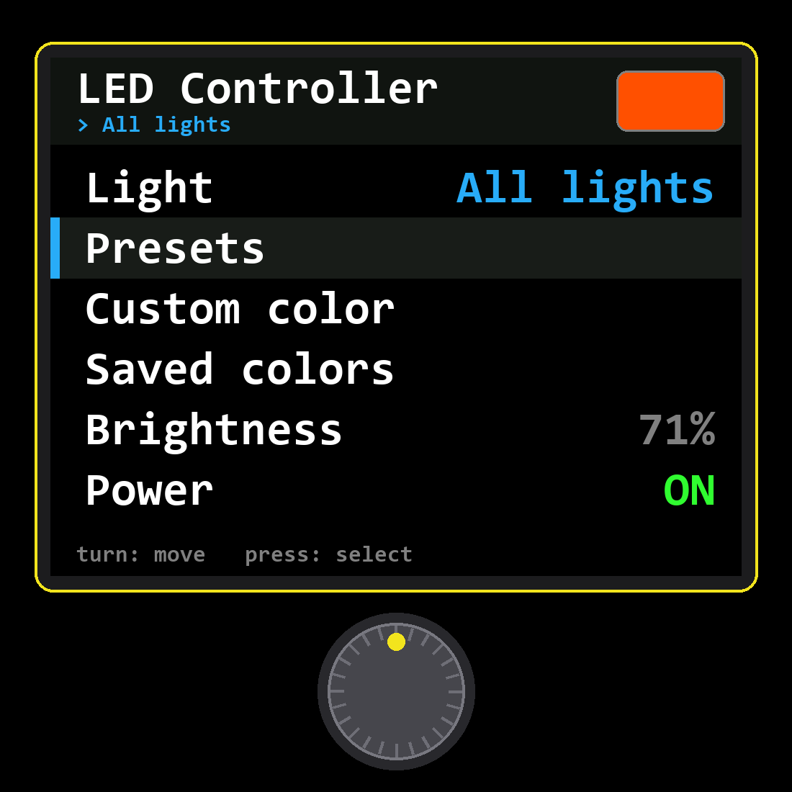
One dial and one
screen control
every light
Turn to move, press to select, hold to go back. Presets and saved colors preview live on the light as you scroll.

Slide 16
13 presets
12 slots
10 strips
Ready-made colors, one press away
Custom colors saved on the controller
Controlled by a single dial

Slide 17
Both boards are built and running; next we test them with real strips and users
Working today
Next steps
The controller menu, presets, custom colors, and saved slots run on the ESP32, and the LED node drives an RGB LED
Connect real LED strips, design a case, and put the prototype in users' hands to collect feedback

Slide 18
Thanks!
Do you have any questions?

